Slide 1

Working with Distributed Teams
Scrum Master – Tips and Techniques
September 1, 2013

Slide 2
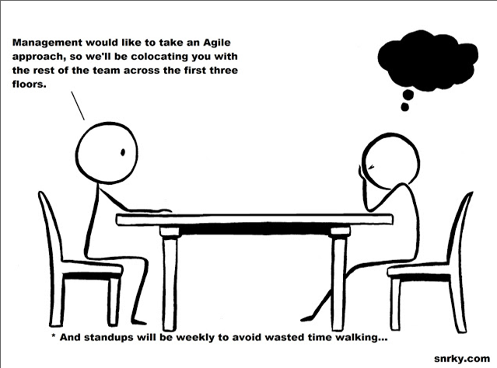
Introduction
What do you believe is the most challenging aspect in working with a geographically distributed team?
Notes:
The most important point to start with is that the principles and practices of Scrum in a project where your resources are distributed are no different from the principles and practices of Scrum where the resources are within the same time zone. It is still Scrum, but with the added challenges brought on by the distances and differences between locations. Notice I didn’t say same location because many large organizations like United Health Care and Optum, it would be more rare to find all your resources being able to be co-located for the project. The Scrum practices enable teams to deliver customer value early and often, add transparency, surface dysfunction, and drive continuous improvement through a simple framework of inspect and adapt. All of which are even more acutely needed in a distributed project, but at the same time are logistically more difficult to conduct.

Slide 3

Distributed Teams
Distributed Teams
USA
4 time zones
Pacific, GMT -8 Mountain, GMT -7 Central, GMT -6
Eastern GMT -5
India
GMT +5:30
Malaysia
GMT +8:00
Notes:
There are many challenges for a distributed team. And those challenges will vary depending upon how geographically disbursed your team is. When the team is primarily all in the same time zone but just lack the face-to-face communication, many of the hurdles being presented today won’t affect you.
However, you may still get some benefit by ideas being offered.
Focus of this presentation is on the obstacles to using Agile Scrum in a distributed team environment and recommendations on how to counter them. The main areas of conversation will be addressing the aspects of the Time Zone Dilemma as it relates to
Agile Team Structure Constraints
Organization Constraints
Availability Issue
Inter-group communication and information sharing

Slide 4

Time Zone Dilemma
The ideal agile scrum team would all be co-located in the same location within the same building. But that isn’t the case within as large an organization as United Healthcare or Optum.
The situation calls for a way to handle the time zone differences between all of the team members.
Break the dilemma down further to areas of how to handle depending upon situation.
Where is everyone? Number of Resources in each time zone.
Your role/function within the team as it relates to the time zone
Depending upon what is being delivered, the role each member on the team and where they are located could have an impact
What Does the Company/Organization Provide to Support Agile Delivery?
Based on security concerns
Based on Funding
Based on organizational support aspect
Who is available for the scrum ceremonies and when?
Notes:
In the next set of slides, you will see some possible ways of how to mitigate these areas of concern.

Slide 5

Agile Team Structure Constraints
The constraints for a team can consist of the following:
No co-located members
Some co-located members
Functional Role of Members are Split
Not all members are 100% dedicated
What to do to mitigate these constraints so the team can be successful? Some possible ways are to:
Utilize the tools UHG or Optum have in supporting agile communication
Ensure you have a boundary spanner resource for those roles necessary
Create a team matrix to visualize the dilemma. See next slides for suggested way of accomplishing this
Notes:
Scrum Team Structure Constraints
You have to assess the roles of each member as to their location. How does that impact each sprint’s goals?
When can each person attend the various scrum ceremonies?
Are there differences in the holidays taken in each time zone? How will that impact the delivery of the business value in each sprint?
Let me show you how you can setup a matrix to help you visualize these constraints and overlaps as it relates to time zone differences and the functional role each team member has.

Slide 6
One Possible Way to Mitigate a Team Structure Constraint
One Possible Way to Mitigate a Team Structure Constraint
Layout the roles, where they are located and their normal working hours. Then choose a time zone to express everyone’s working hours as that time zone so it can be clear when people are working when.
Role | Location | Time Zone | Normal Work Hrs | Expressed as Central Time
Product Owner | Connecticut | Eastern | 8 to 5 pm | 7 to 4 pm
Scrum Master | Minnesota | Central | 8 to 5 pm | 8 to 5 pm
Developer – UX | New Jersey | Eastern | 9 to 5:30 pm | 8 to 4:30 pm
Developer – UI | Wisconsin | Central | 8:30 to 5 pm | 8:30 to 5 pm
Developer – Server | California | Pacific | 9 to 6 pm | 11 to 8 pm
DA | Florida | Eastern | 8 to 5 pm | 7 to 4 pm
SA | California | Pacific | 8 to 5 pm | 10 to 7 pm
QA | Minnesota | Central | 8 to 5 pm | 8 to 5 pm
QA | India | IST | 11:30 am to 8 pm Monday | Midnight to 9:00 am Tuesday (Winter Schedule)
Notes:
By creating this matrix for your scrum team, and purposefully creating a column for a time zone standard so that it is clear when a person is available based on their working hours, it makes it possible for you to facilitate negotiations with the team on when to do what.

Slide 7
One Possible Way to Mitigate a Team Structure Constraint (cont.)
With the team structure matrix created, you have the ability to assess and negotiate:
When to hold the various scrum ceremonies
Immediately setup the re-occurring meetings in Outlook for the team
During sprint planning determine who will do what tasks; keep in mind how well the different resources will be able to do real time chatting with one another
If real time chatting isn’t possible, during sprint zero planning, introduce the process of using the discussion feature within Rally to facilitate discussion among the team members. It’s one of the ways to mitigate this obstacle.
If it becomes clear there is a need to have an additional resource to work the hours necessary to span the time zone differences between team members, address this with the Product Owner and IT management to obtain such a resource.
Example: Developers are all onshore, but the QA resources are all offshore. Negotiate to have an onshore QA lead that not only does some of the testing but interfaces more closely with the offshore resources.

Slide 8

Company/Organization Constraints
There are constraints for distributed teams based on company standards, policies and funding. These can include:
Software
Policy doesn’t allow certain software to be used
Ability to instant message
UHG standard software doesn’t support MAC workstations well
Equipment
Lack of webcams
Test labs
Funding
The standard tools available for the developers, system analysts, data architects, or testers are fully sufficient for optimized effectiveness
Cultural
Recognize that common words can mean different things in each region of the US and in each country, promoting miscommunication.
Different holidays are honored in each country
Notes:
Some of these organizational constraints will not be overcome. Instead it becomes important to understand them and their impact.
For instance, UHG policy doesn’t allow certain software to be installed on your workstation that developers are wanting or to support a customer such as specific browsers and their versions like Chrome or latest version of IE, Firefox or Safari.
Other constraints can be handled by having a meeting with the development team to come up with a plan so that it can be presented to the business for funding.

Slide 9
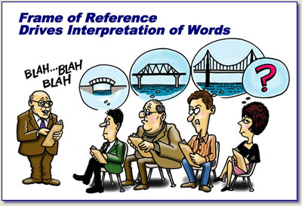
Possible Ways to Mitigate Company/Organization Constraints
What can be done to mitigate these constraints so the team can be successful? Some possible ways are:
Cultural mitigation possibilities
Create a holiday calendar for the team and post it on the team SharePoint
Paraphrase and reflect what a person has said to ensure complete understanding is had within the discussion. This action is known as reframing and is a valuable communication tactic. Sometimes the same word can mean different things. For instance, people from northern US consider a sack to be made of burlap, while someone from the southern US may think of it as a paper lunch bag you carry your sandwich in.
Notes:
Reframing what you are hearing takes practice. The reason this soft skill is valuable is because it minimizes any future conflicts. It can also unearth actual wants and needs that were not expressed as clearly as it could have been.
When should you consider reframing an issue or what you just heard in a meeting?
When you begin to hear the elevation in peoples voices (pitch, tonal quality, volume) as they talk about a topic under discussion
When you are attempting to influence what is on the agenda
When it isn’t clear what is being asked. This happens quite a bit during grooming sessions for stories.

Slide 10
Possible Ways to Mitigate Company/Organization Constraints
Software mitigation possibilities
For obtaining software you can check out software at AVS: http://avs.uhc.com/ and then submit the request through the AppStore: http://appstore.uhc.com/
Obtain administrative rights for your workstation (LWAR): https://secure.uhc.com/
Equipment mitigation possibilities
Obtain a virtual test lab if you need to do multi-browser testing on non supported browsers. See Lab Requests: http://isrm.uhc.com/LSRFormRequest.aspx
Funding mitigation possibility
Work with your development team to determine a plan of action with broad estimates and include impact analysis. Make it compelling. Present a plan to both the Product Owner and appropriate IT Management so they can obtain the necessary funding and permissions.
Notes:
This can be as simple as a summary within an email if the funding is quite small.
Or during the implementation of a story it becomes known by the implementation team how if you take the path to get the story to completed could cause maintenance or performance issues in the long term. You can present these findings with the options to the Product Owner during the collaboration portion of your scrum call. Renegotiate the stories for the sprint you are in.
If it is a larger effort though, follow the principles established in writing a business plan and just tailor it for the purpose of the proposal to the business and IT management. It should contain
Statement of the problem
The various options or solutions to the problem
Who will this benefit; your target market
The costs, which typically is amount of time to deliver the solution including any additional impacts to other systems or departments. List them.
Why it is best to implement this proposal; your compelling reason to do it

Slide 11

Meeting Availability Issue
Product Owner has time constraints and is only available during certain time periods
If one person on the scrum team can be considered a non-negotiable element and needed to attend all meetings, it is the product owner. The PO is key for the team to be successful in delivering the business value expected in a project.
Other Scrum Team member’s availability considerations
Normal working hours do not overlap other team members in the other country/region’s location
Minimized collaboration across functional roles due to time zone differences creates issues in implementing and demoing a story within a sprint
Holidays are different across organization
Notes:
Product Owner is key in all meetings for the success of the agile project
When in your sprint zero and determining the schedule for setting up the various meetings, make sure that the meetings can be consistently at the same time and interval for the duration of the release.
But ensure it is encompassing the Product Owner’s time table as the priority; then the rest of the team.
This can be challenging when you have a team not only spread apart geographically, but also if the various team members may not be 100% allocated to the effort.
When assessing the rest of the team’s availability, keep in mind what skillset they are bringing to the team.
The time zone matrix that was created earlier could be expanded to list the actual team member’s name and what implementation role they provide. It may become more visually apparent where possible gaps are in being able to setup the strategies to handle the communication across the whole team.

Slide 12
Mitigating Meeting Availability Issue
Product Owner is key in all meetings for the success of the agile project
Specify the dates and times of sprint ceremonies during the team chartering of Sprint Zero, receiving a commitment from all, including the product owner, that they will attend all of the ceremonies
Should the PO not be fully available, encourage the business to ensure a Proxy can stand in and make the decisions the PO would have made if they were present in the respective meeting.
Schedule an hour long daily scrum call. Have the first 15 minutes dedicated as the daily standup, while the last 45 minutes is dedicated for collaboration with the team and product owner.
Do your best when scheduling these calls to include all of the team members. Hence if the offshore team leaves by 9 am central time, have your daily scrum call start at 8 am CST. Here’s a spreadsheet that can be used to understand the time zone differences between India, Philippine and USA.
If this isn’t possible due to the time zone issue, ensure you have a resource as a boundary spanner; a person fulfilling a functional role and works across multiple time zones.
Notes:
You will find that when the product owner or their proxy isn’t present at these meetings, velocity suffers.
Create an hour long daily scrum call instead of just 15 minutes. Use the extra 45 minutes to:
Demo of completed stories to the product owner for obtaining acceptance of the story and continue to move forward
Answer questions or concerns the product owner may have
Groom additional stories in the release backlog to get ready for the next sprint planning session
Talk about resolution of impediments with the members that have them; allow the other associates during that time to leave if they are not involved in the discussion
Having a resource who can work within the two or more time zones to ensure communication and continued success at completing a story is an important mitigation strategy. When the team is being setup, pay attention to the overall functionality that is wanted by the business (found in the PRD) as you look at each individual’s skillset to implement them. Note what time zone they work in. Then take a typical sprint and layout in your mind, how the workflow can progress. Make sure to include the QA and demoes of the stories. By painting a picture for yourself, it becomes more obvious where the potential bottlenecks are.
You can take some different approaches. You can recommend to the PO to fund for an additional boundary spanner resource. Or during sprint zero, you can then use Socratic questioning techniques to lead the discussion to the processes the team will take to handle this.

Slide 13
Inter-group communication and information sharing
Communication will make or break an agile project
Make live communication as effortless as possible
Create an Outlook Distribution List for the team. See UHG IT Provisioning portal: https://aps.uhc.com/Portals/dl_new.aspx
Encourage everyone to use the distribution list when communicating by email
Instill awareness of team member time zones every opportunity that may present itself
Have a Holiday and PTO calendar for the team created and posted on the team SharePoint. Holidays should be clearly marked as offshore or onshore ones.
Encourage the use of the discussion feature within Rally, the tool used at UHG and Optum Technology. See the Rally tips and tricks video: https://uhg.webex.com/uhg/ldr.php?AT=pb&SP=MC&rID=19422422&rKey=de86ad9a1f0ecfae
Notes:
Communication will make or break an agile project
All communications relevant to the project team members should go to every member of onsite and offshore team. It can be good news, bad news or simple updates. After all, offshore and onsite team members are aiming for the same goal and vision.
Whenever you are holding a meeting and scheduling another is required, ensure to remind everyone the time zones that everyone on the team is located and how best to accommodate as many of them as possible
In a meeting in which not everyone can be present but a response will be expected by them, set the expectation correctly.
It may be advantageous for you to demonstrate in one of your meetings with the team how to utilize the discussion feature within Rally. It will be necessary to show how to setup notifications so that members know when a discussion has been added to a story so they can review it ahead of any meetings.

Slide 14
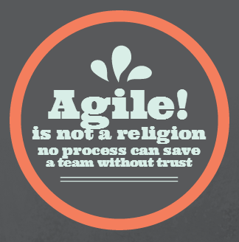
Additional Tips and Best Practices
Work hard towards creating a one team feeling
Remember that offshore team may be not familiar with your work culture, language and team members.
Create an online site (SharePoint) where a team can collaborate, exchange ideas and inspire one another. See the URL for more information - http://it.uhg.com/At_Your_Service/SW/Pages/SharePointCollaboration.aspx
Organize and create a virtual party with team members sending in their pictures and creating a deck to share with everyone.
Build trust among everyone
Trust is a mental state of reliance on the integrity of a person. When you trust someone you believe that he or she is going to do what you expect.
Notes:
Tip: Work hard towards creating one team feeling
Remember that offshore team may be not familiar with your work culture, language and team members. Spend a few social times together to create one team feeling.
Make sure that the beginning part of your daily scrum call includes sharing of personal stories. It can be as simple as what happened on your way to work that morning. This will promote the feeling of one team
Organize a virtual party to help get faces to names and more aware of who we are - outside. Everyone takes their favorite snapshot and send it in. Create a deck with those pictures of celebration, hobbies, dogs, kids, football, whatever. Get them engaged and have some fun at the same time.
Tip: Build trust among everyone
This will take time with a brand new team in which no one is familiar with each other and their work habits. So have patience.
You know trust is there when the team members freely talk to each other and ask for help or ask questions during the scrum call without any prompting.

Slide 15
Tips and Best Practices (continued)
Cultivate boundary spanners; resources that can communicate directly with offshore associates but also with onshore associates
Break the team’s work up so progress in one location is not overly dependent on progress in another.
Equalize the workload among the team. Uneven workloads cause bottlenecks and loss of productivity. Keep in mind the time zone differences when handing off work to other team members.
If development work is split across time zones, have a consistent process for check-ins and successful builds.
Ensure there is an agreed upon communication process in place for showing when work was completed and is ready to be handed off to the next functional role.
Notes:
Tip: Build trust among everyone (continued from previous slide notes)
How to build trust is by
Encouraging honesty and transparency even it means exposing a flaw in original estimates, designs, or having to just give bad news to the product owner. When breaking bad news to the product owner ensure you have a mitigation strategy to also share at the same time; provide options.
Keeping your word and by that example expect the same from everyone else on the team. Don’t make promises you can’t keep.
Persevering in your commitments. It’s a subset of keeping your word. Hence, keep working towards the goals despite the obstacles, difficulties or discouragement. It will be noticed by others. Respect is then gained.
Having integrity. It means to act fairly. Act upon your moral and ethical principles and not just upon material interests, and to help others to achieve what they want.
Tip: Cultivate boundary spanner resources
An example is when you have QA offshore but development team is onshore. Attempt to have an onshore QA lead who will interface with the offshore associates as well as the onshore development team. Span the hours between the two geographically and time challenged zones.

Slide 16
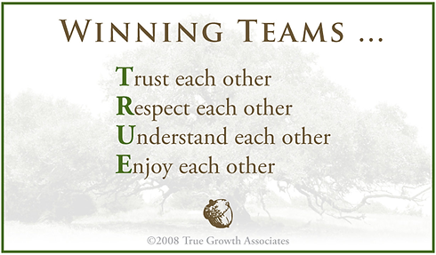
Last Thoughts and Summary
During your sprint zero, make it a point to address as many of these concerns we covered about working within a team that is widely distributed.
Utilize the mitigation strategies presented
Using team distribution lists for emails
Using the Rally discussion feature
Scheduling all meetings for the whole release with the PO as primary consideration and then balancing the rest of the team’s timelines.
If needed, have resources who can span the boundaries of the time zone dilemma to increase the necessary communication and information sharing
Create a one team feeling by organizing virtual parties
If you have any questions, please reach out to your Agile coach or send an email to the Agile Practices Team <agile_sw_eng@uhc.com>

Slide 17
Thank you.
Agile Software Engineering Practices
agile_sw_eng@uhc.com

